Slide 1
Project Review 2
Ticket Booking System
GoVeya: multi-modal booking for bus, train and flight tickets
SRR. Keerthi
ID: 2520090150
P. Jahnavi
ID: 2520090012

Slide 2
Problem Statement
Many users try to book the same seat at the same moment
Without control, one seat is sold twice (double booking)
Bus, train and flight tickets sit in separate apps
Users need reliable, up-to-date seat availability
Double booking: the problem
User A
Seat 12A
User B
Both get confirmed

Slide 3
Objectives
One platform to search and book bus, train and flight tickets
1
Interactive seat maps showing free and occupied seats
2
Stop double booking using database transactions and locking
3
Booking history and an admin panel to monitor bookings and payments
4

Slide 4
Proposed System
1. Search
2. Select Seat
3. Passengers
4. Payment
5. E-Ticket
Route, date, passengers
Pick from seat map
Details of each traveller
UPI, net banking, card
Ticket with QR code
Safe booking (backend)
Smart Journey
Check seat is free inside a transaction
Lock the seat before confirming
Second user gets a “seat taken” reply
Combine bus, train and flight legs
Compare time, cost and risk
Already built in the frontend

Slide 5
System Architecture
Presentation layer
Application layer
Data layer
Built
Planned
Planned
React 19 + TypeScript
Tailwind CSS, Router
Pages, forms, seat maps
HTTP / JSON
Java REST API
Booking and login logic
Transaction handling
JDBC / SQL
MySQL database
Users, seats, bookings
Locks and constraints
Fig 1. Three-tier architecture. Solid = built, dashed = planned
Concurrency control sits between the API and the database.

Slide 6
Modules / Functionalities
Login & Signup
Search & Filters
Seat Selection
Passenger Details
Payment
UI done
UI done
UI done
UI done
UI done
E-Ticket + QR
User Dashboard
Admin Dashboard
Smart Journey
Concurrency Control
UI done
UI done
UI done
UI done
Planned
UI done = built and shown in screenshots. Data is sample data for now.

Slide 7
Frontend Design
Home page
Login / Registration
Choose Bus, Train, Flight or Smart
Search form with city picker
User login and signup pages
Separate admin login
Forms
Dashboard
Search and filter form
Details form for every passenger
User: booking history and status
Admin: stats, revenue, payments
Built with React and Tailwind. Dark and light theme toggle in the header.

Slide 8
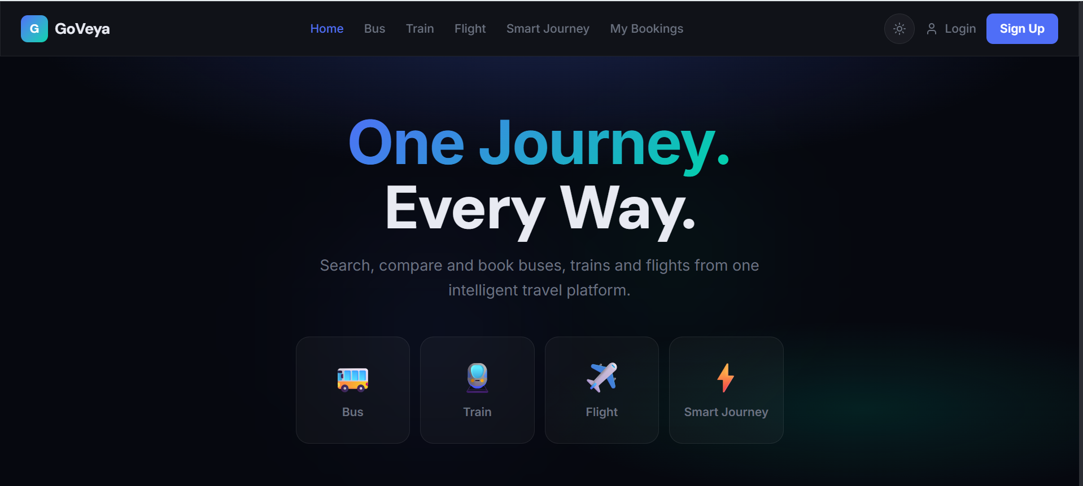
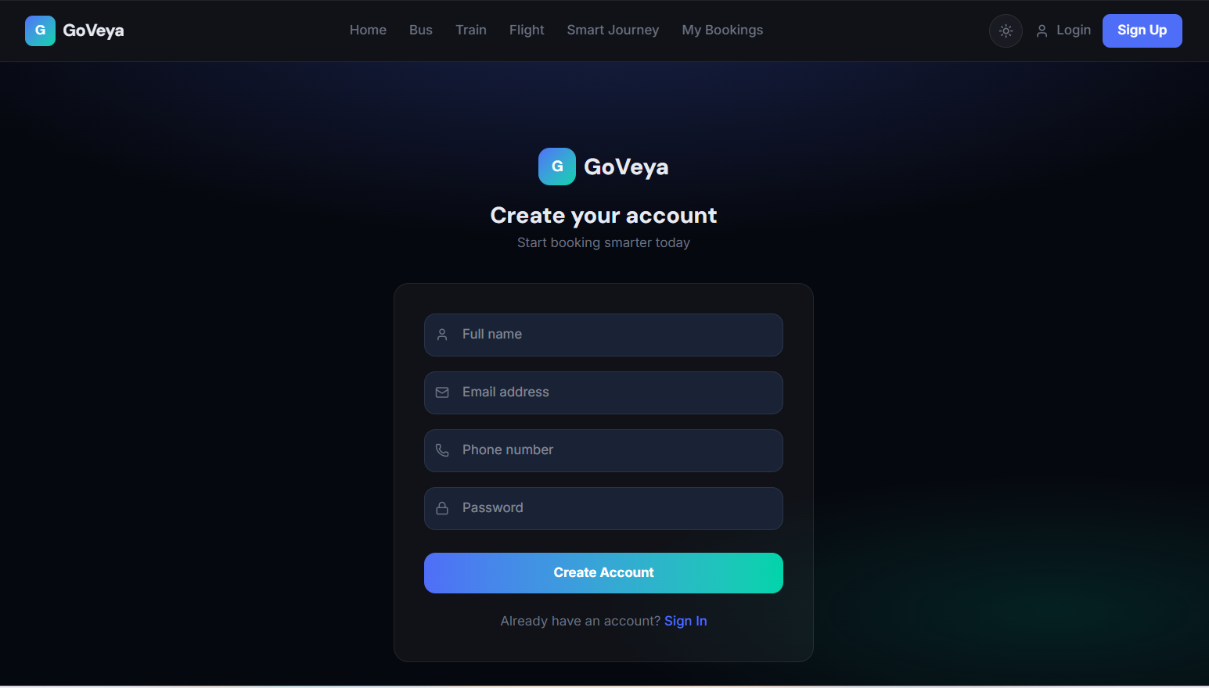
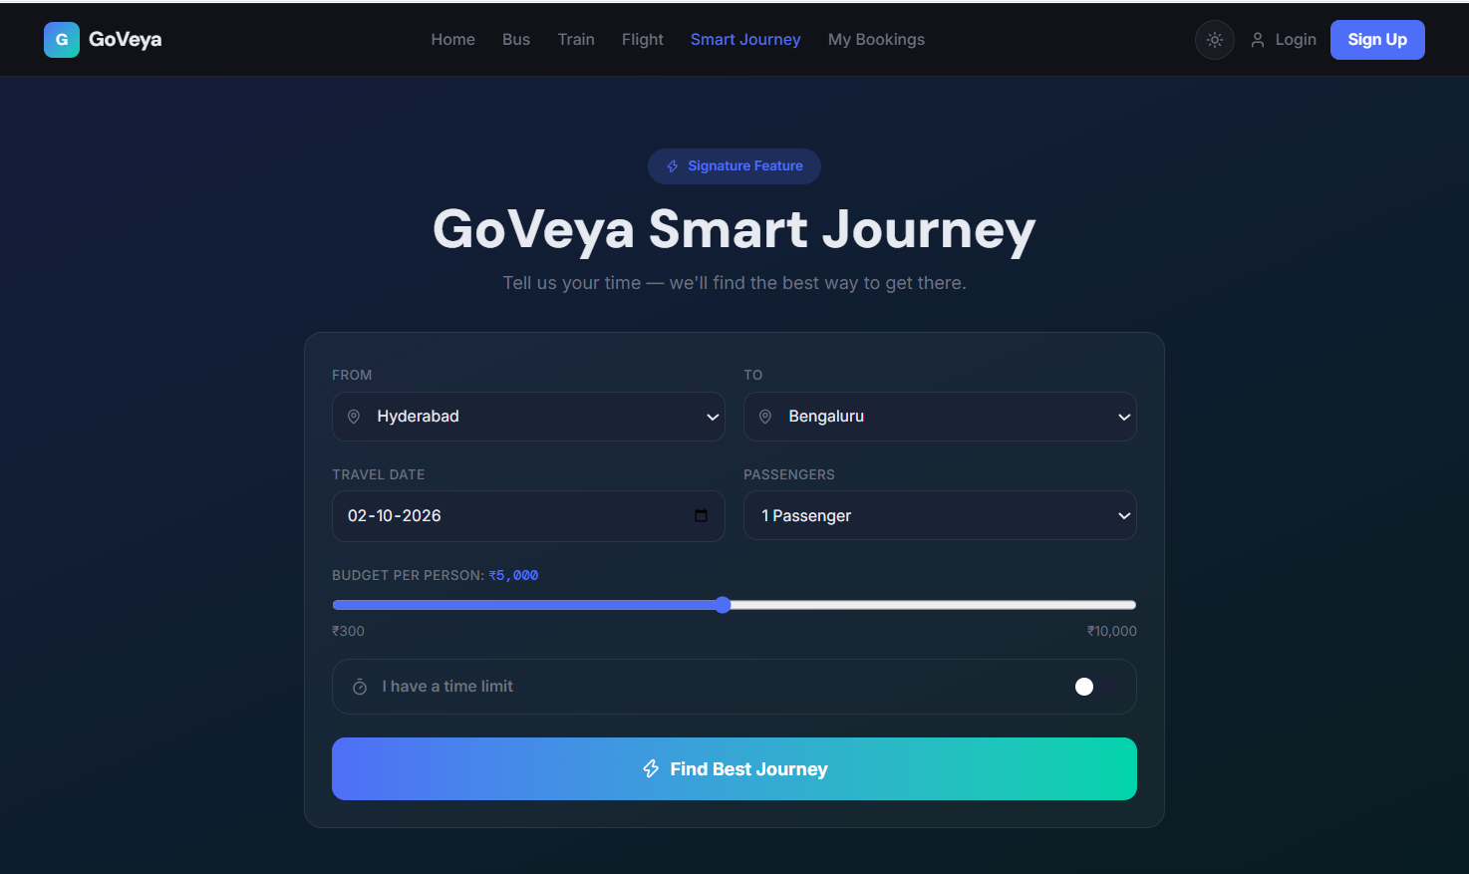
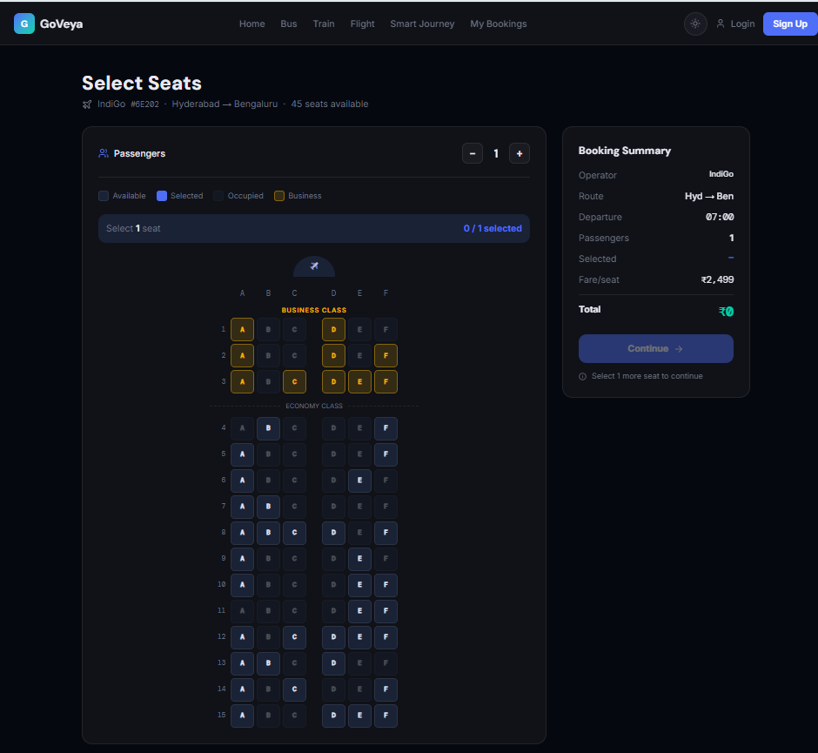
Frontend Implementation: Pages
Insert screenshot
route: /
Insert screenshot
route: /login, /signup
Navigation
Splash → landing gate → Home
Pick Bus, Train, Flight or Smart
Header links to Login and Dashboard
Fig 2. Home page
Fig 3. Login and Signup
Insert screenshot
route: /search/bus
Insert screenshot
route: /seat-selection
Fig 4. Search results with filters
Fig 5. Seat selection

Slide 9
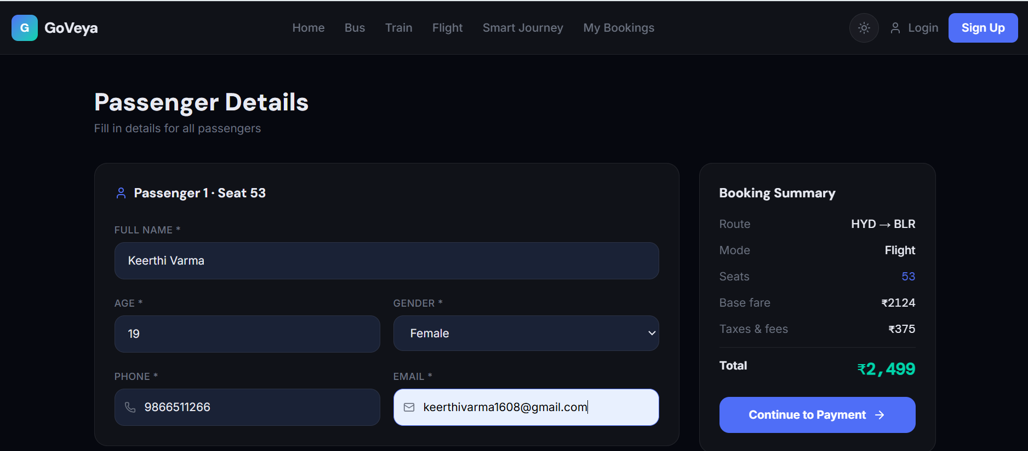
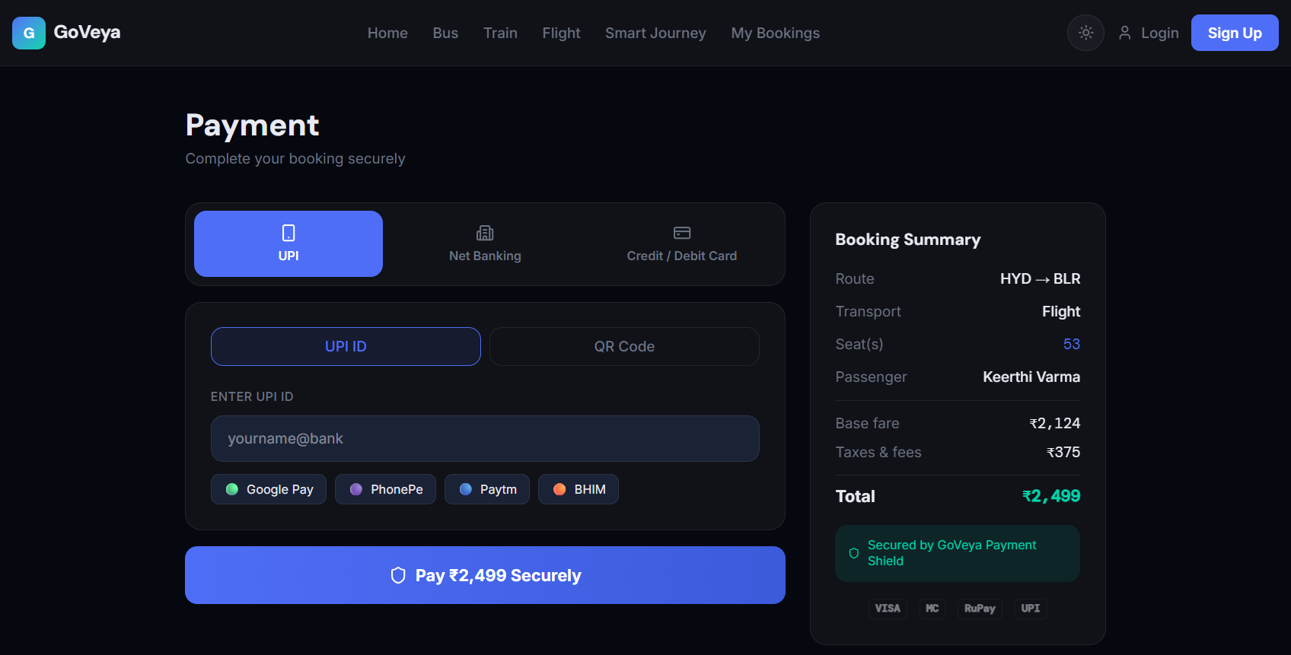
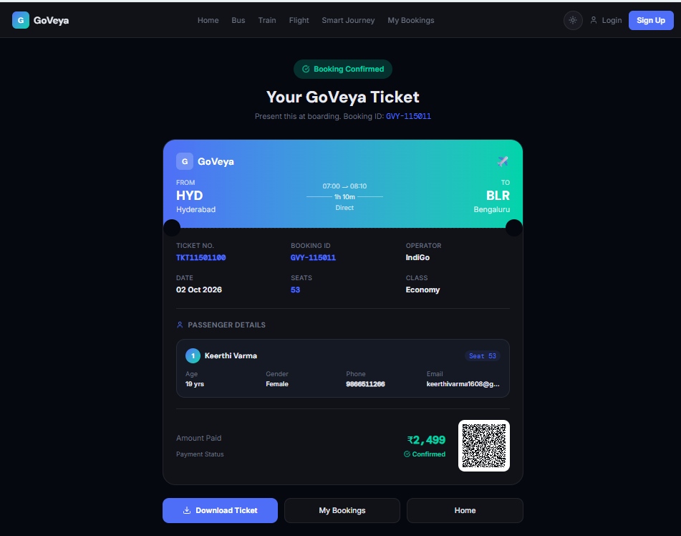
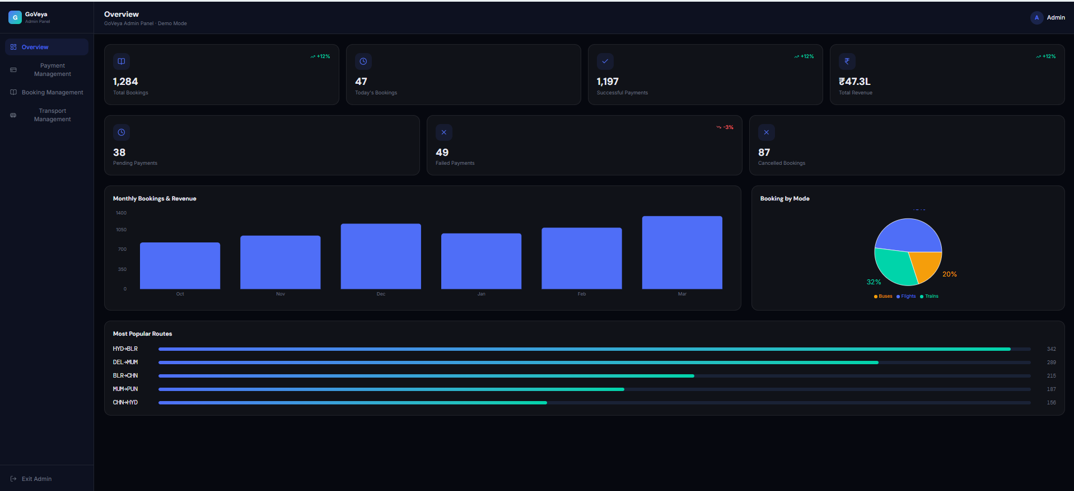
Frontend Implementation: Forms & Dashboards
Insert screenshot
route: /passenger-details
Insert screenshot
route: /payment
Booking flow
Seat → Details → Payment → Ticket
Ticket has a scannable QR
Dashboards list bookings and stats
Fig 6. Passenger details form
Fig 7. Payment (UPI / Bank / Card)
Insert screenshot
route: /ticket
Insert screenshot
route: /dashboard, /admin/dashboard
Fig 8. E-ticket with QR code
Fig 9. User and Admin dashboards

Slide 10
Database Design: ER Diagram
Design stage
USER
BOOKING
PAYMENT
user_id (PK)
name
email
role
booking_id (PK)
user_id (FK)
transport_id (FK)
status
payment_id (PK)
booking_id (FK)
method
status
places 1:N
paid by 1:1
for N:1
includes 1:N
TRANSPORT
SEAT
PASSENGER
transport_id (PK)
type
from_city, to_city
price
seat_id (PK)
transport_id (FK)
seat_no
status
passenger_id (PK)
booking_id (FK)
seat_id (FK)
name
has 1:N
holds 1:1
Fig 10. ER diagram. PK = primary key, FK = foreign key, 1:N = one-to-many

Slide 11
Database Tables / Schema
Design stage
Table | Columns | Purpose
users | user_id (PK), name, email (UNIQUE), password_hash, phone, role | Travellers and admins
transport | transport_id (PK), type, operator, from_city, to_city, departure, arrival, price, total_seats, rating | Bus, train, flight schedules
seats | seat_id (PK), transport_id (FK), travel_date, seat_no, status. UNIQUE (transport_id, travel_date, seat_no) | One row per seat per trip
bookings | booking_id (PK), user_id (FK), transport_id (FK), travel_date, status, total_amount, created_at | One booking per trip
passengers | passenger_id (PK), booking_id (FK), seat_id (FK), name, age, gender, phone, email | One row per traveller
payments | payment_id (PK), booking_id (FK), method, amount, status, paid_at | UPI, net banking, card
The UNIQUE key on seats is what blocks a second booking of the same seat.

Slide 12
Sample Database Records
Sample data
transport
transport_id | type | operator | route | departs | price
BUS001 | bus | IntrCity SmartBus | Hyderabad → Bengaluru | 21:00 | ₹799
12163 | train | Chennai Express | Hyderabad → Bengaluru | 06:10 | ₹545
6E202 | flight | IndiGo | Hyderabad → Bengaluru | 07:00 | ₹2,499
12001 | train | Shatabdi Express | Delhi → Mumbai | 06:00 | ₹1,295
bookings
booking_id | type | passenger | seat | amount | status
GVY-2024-001 | flight | Arjun Sharma | 12A | ₹2,499 | confirmed
GVY-2024-002 | train | Priya Patel | B2-24 | ₹1,295 | upcoming
GVY-2024-003 | bus | Rahul Kumar | 5B | ₹399 | completed
From the website’s sample data: 50 buses, 50 trains, 99 flights. To be loaded into MySQL.

Slide 13
Current Progress
Completed
In progress
Pending
12 pages and routes
Search, filters, seat maps
Forms, payment UI, QR ticket
User and admin dashboards
ER diagram and schema
REST API design
Java backend
MySQL setup and connection
Real login, safe booking
Evidence for completed items: screenshots on slides 8 and 9.

Slide 14
Challenges / Issues Faced
Challenge
How we will solve it
Seat status is generated in code, not stored
Store seats in MySQL, one row per seat per trip
Pages pass data through URL parameters
Send data through backend APIs instead
Login checks run only in the browser
Move authentication to the Java backend
Concurrent booking cannot be tested yet
Use transactions and row locks once backend is ready

Slide 15
Future Work & Conclusion
Future Work
Conclusion
Build Java REST API
Create MySQL database, load data
Add transactions and row locking
Real login and payment gateway
Test with many users at once
Frontend is complete and can be demonstrated
Database design is ready
Next: backend and safe, double-booking-free reservations

